Slide 1
Lesson 21: Methods of System Analysis
ET 438a Automatic Control Systems Technology

Slide 2
Learning Objectives
After this presentation you will be able to:
Compute the value of transfer function for given frequencies.
Compute the open loop response of a control system.
Compute and interpret the closed loop response of a control system.
Compute and interpret the error ratio of a control system.

Slide 3
Frequency Response of Control Systems
Control limits determined by comparing the open loop response of system to closed loop response.
Open loop response of control system:
Error = SP
Controller
Manipulating element
Process
SP
G(s)
+
-
C(s)
C_{m}(s)
Measurement disconnected from feedback
H(s)
Where:
C_{m}(s) = measurement feedback
SP(s) = setpoint signal value
G(s) = forward path gain
H(s) = feedback path gain
Measurement System

Slide 4
Frequency Response of Control Systems
Closed loop response of control system:
Input
SP
G(s)
+
-
C(s)
C_{m}(s)
H(s)
Output
Note: this is not the I/O relationship that was used earlier. (C(s)/SP(s))

Slide 5
Frequency Response of Control Systems
Frequency response of system divided into three ranges:
Zone 1- controller decreases error
Zone 2 - controller increases error
Zone 3 - controller has no effect on error
SP change frequency determines what zone is activated. Overall system frequency determines values of zone transition frequencies
Error Ratio (ER) plot determines where zones occur
Replace s with jω and compute magnitude of complex number

Slide 6
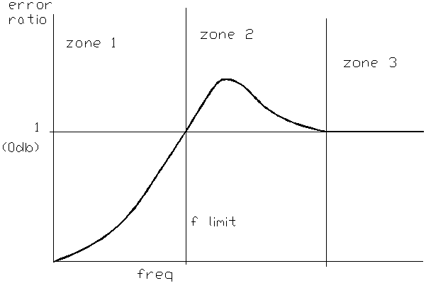
Frequency Response of Control Systems
Typical Error Ratio plot showing operating zones and controller action
Error reduced
No Effect
Error increased

Slide 7
Computing Transfer Function Values
Example 21-1: Given the forward gain, G(s), and the feedback system gain, H(s) shown below, find 1) open loop transfer function, 2) closed loop transfer function, 3) error ratio.
4) compute the values of the open/closed loop transfer functions when
=0.1, 1, 10 and 100 rad/sec. 5) compute the value of the error ratio when ω=0.1, 1, 10 and 100 rad/sec. 6) Use MatLAB to plot the open and closed loop transfer function responses on the same axis.

Slide 8
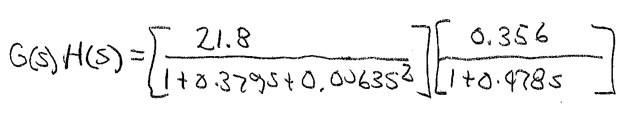
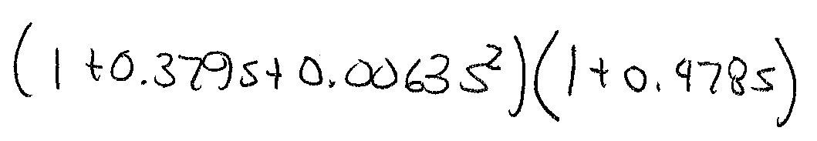
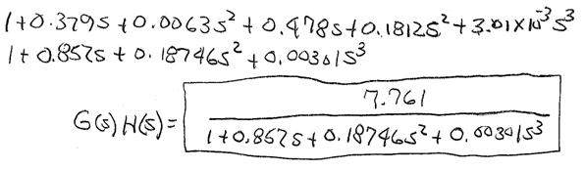
Example 21-1 Solution (1)
1) Open Loop Transfer Function
Expand the denominator
Ans

Slide 9
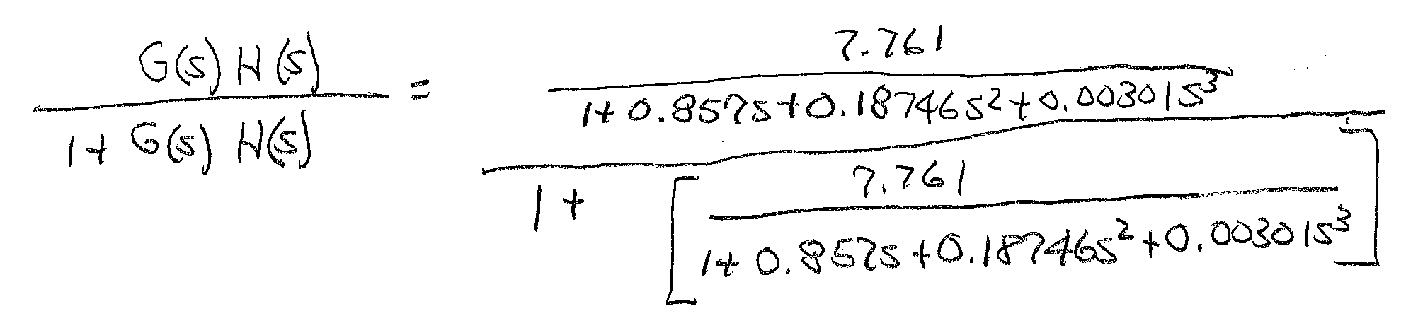
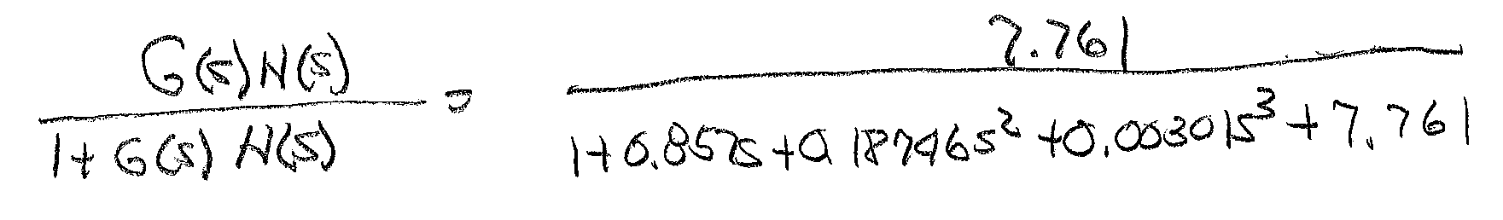
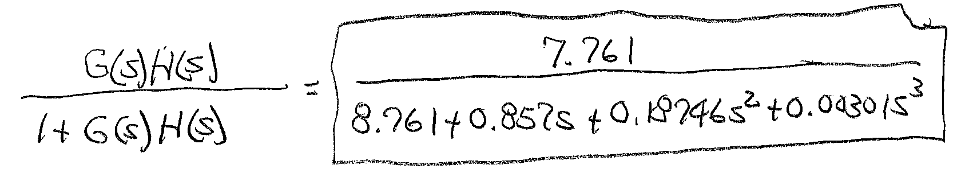
Example 21-1 Solution (2)
2) Find closed loop transfer function
Multiply numerator and denominator by 1+0.857s+0.18746s²+0.00301s³ and simplify
Ans

Slide 10
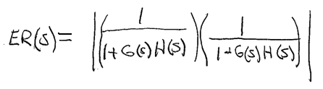

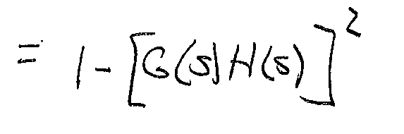
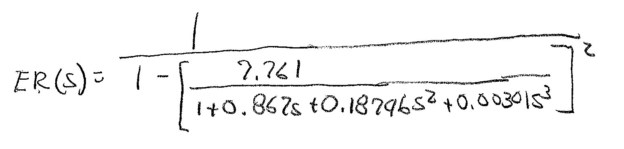
Example 21-1 Solution (3)
3) Find the error ratio
Magnitude only
Expand denominator and simplify
Substitute in G(s)H(s) from part 1 into above

Slide 11
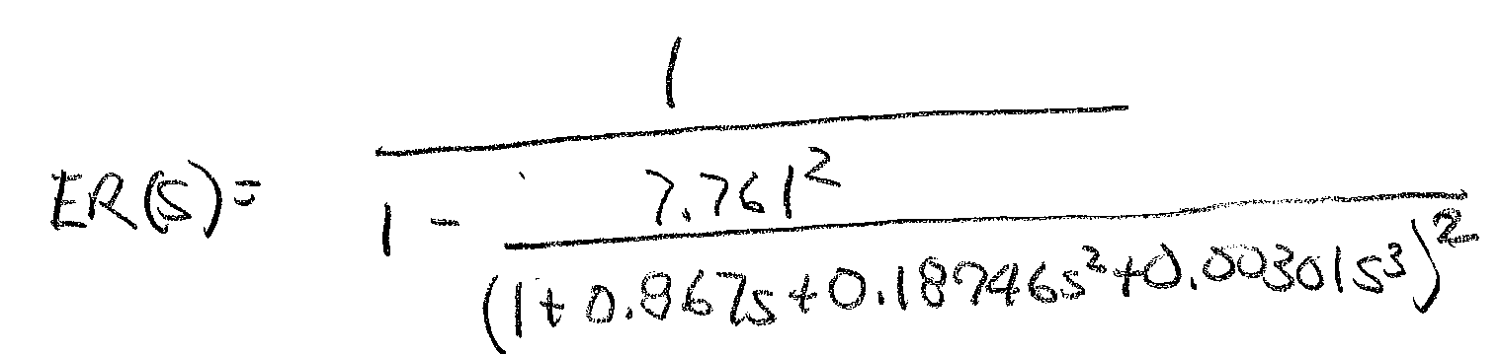
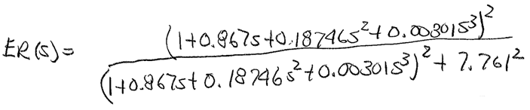
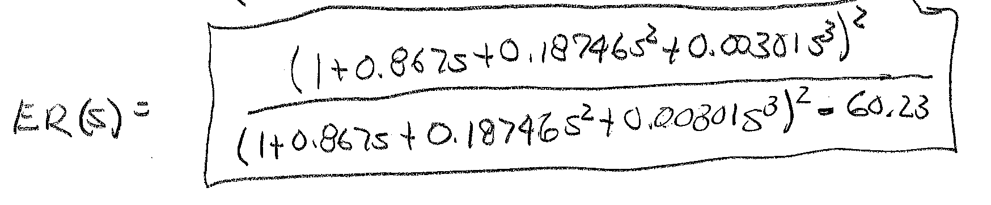
Example 21-1 Solution (4)
Error ratio calculations
Ans

Slide 12
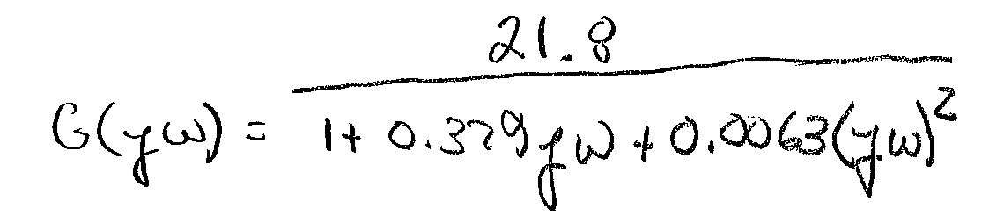
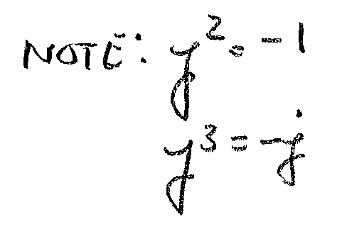
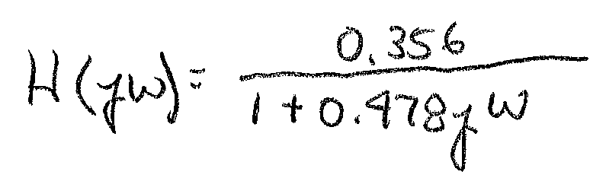
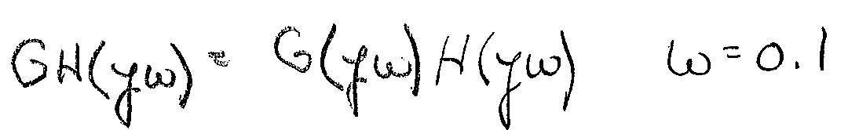
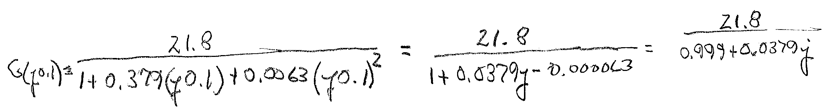
Example 21-1 Solution (5)
4) Compute the values of the open and closed loop transfer functions for
ω=0.1 1 10 100 rad/s Substitute jω for s
Open loop

Slide 13
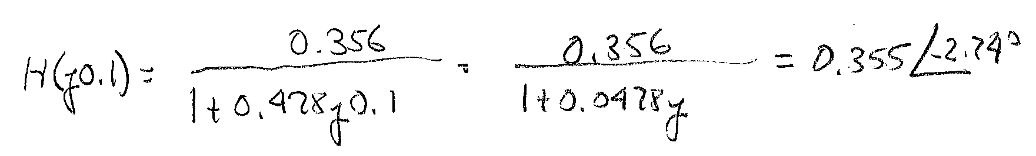
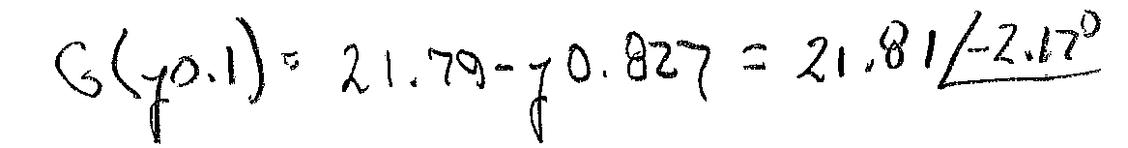
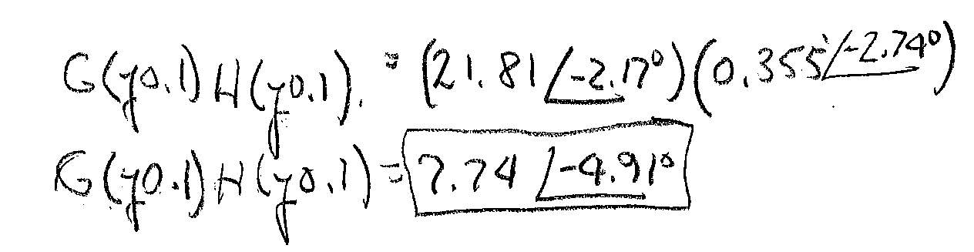
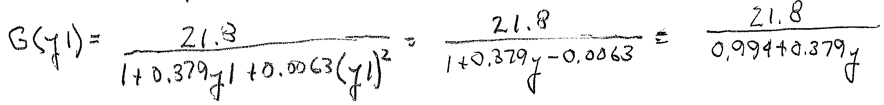
Example 21-1 Solution (6)
Now for ω=1 rad/sec

Slide 14

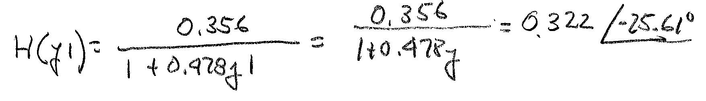
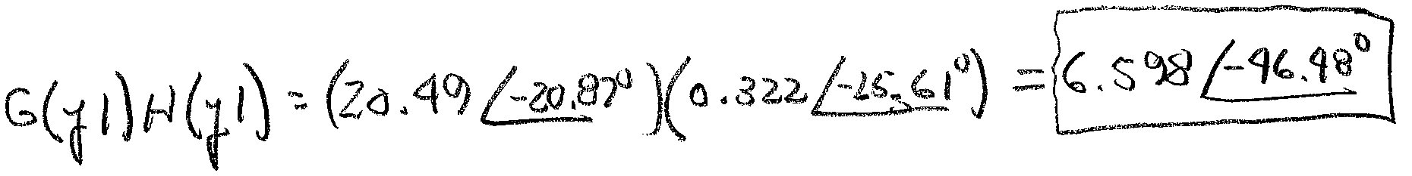
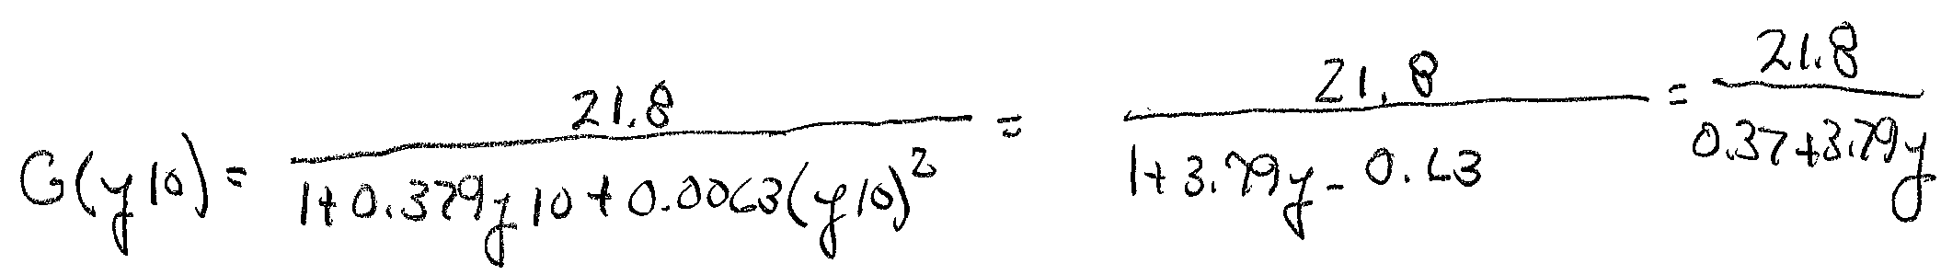
Example 21-1 Solution (7)
Now for ω=10 rad/sec

Slide 15

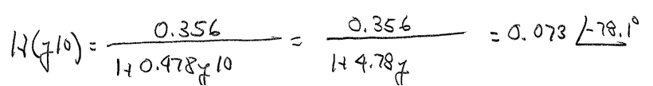
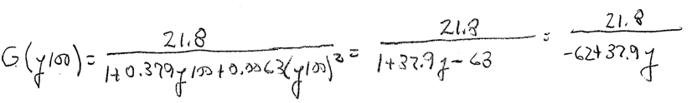
Example 21-1 Solution (8)
For ω=100 rad/sec

Slide 16

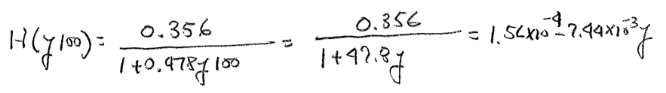
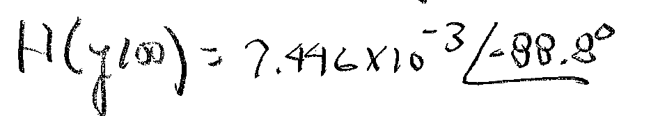

Example 21-1 Solution (9)

Slide 17
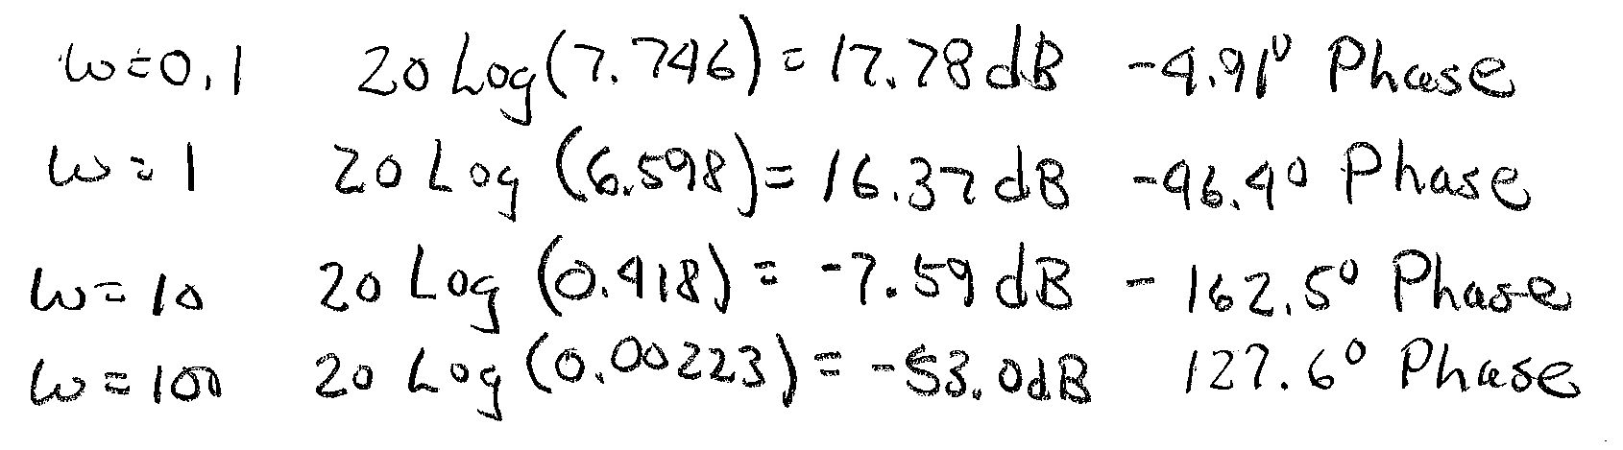
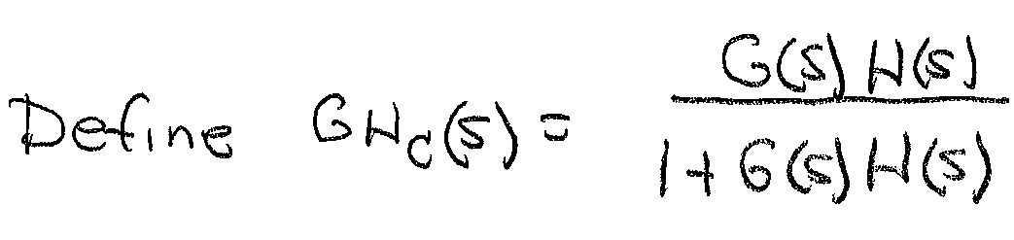
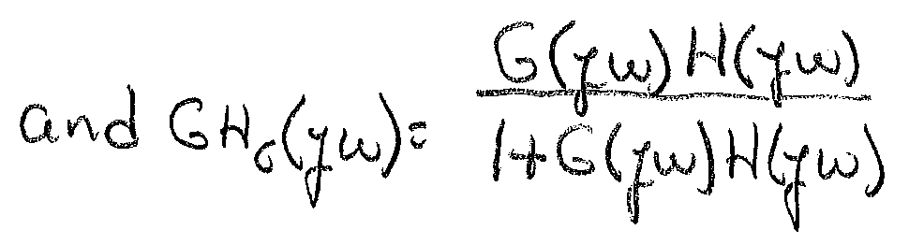
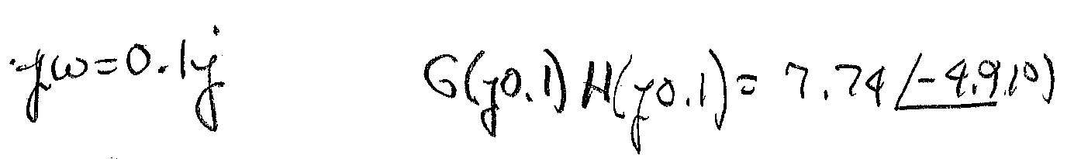
Example 21-1 Solution (10)
Convert all gain values into dB
4) Compute the close loop response using the previously calculated values of G(s)H(s)

Slide 18
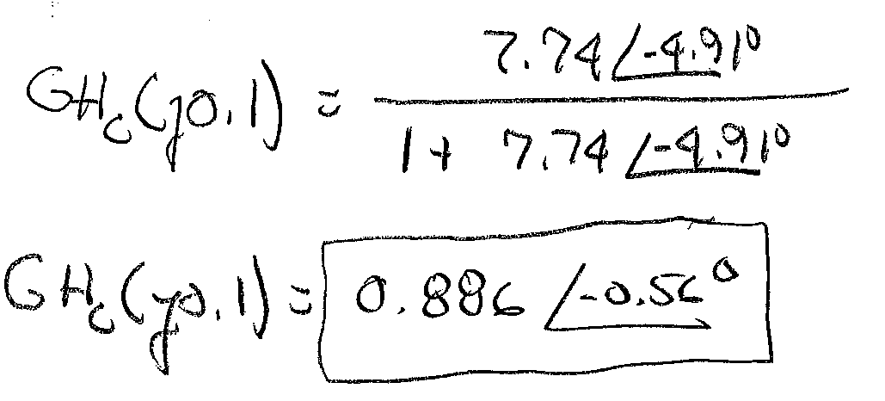
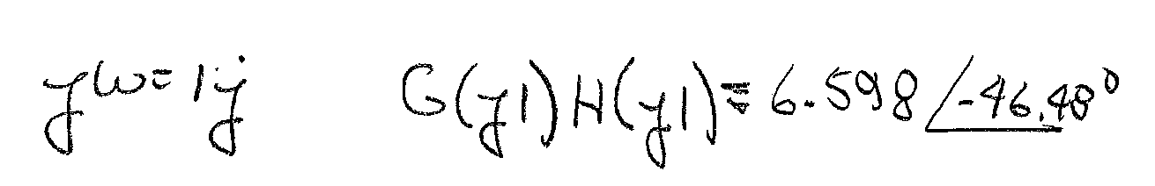
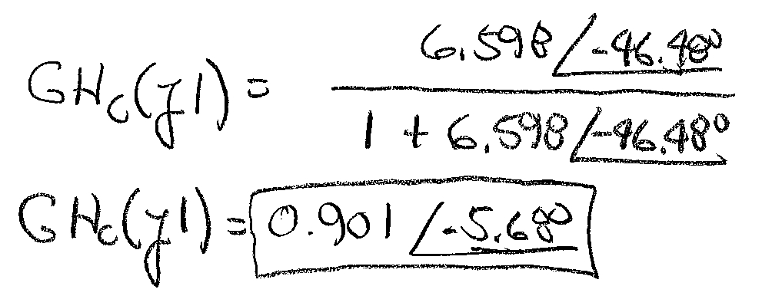
Example 21-1 Solution (11)

Slide 19
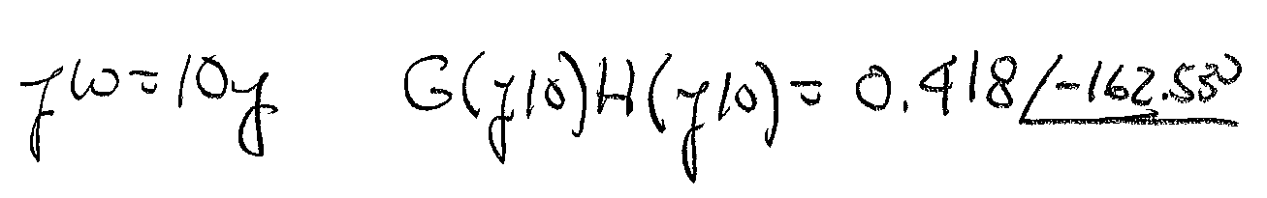
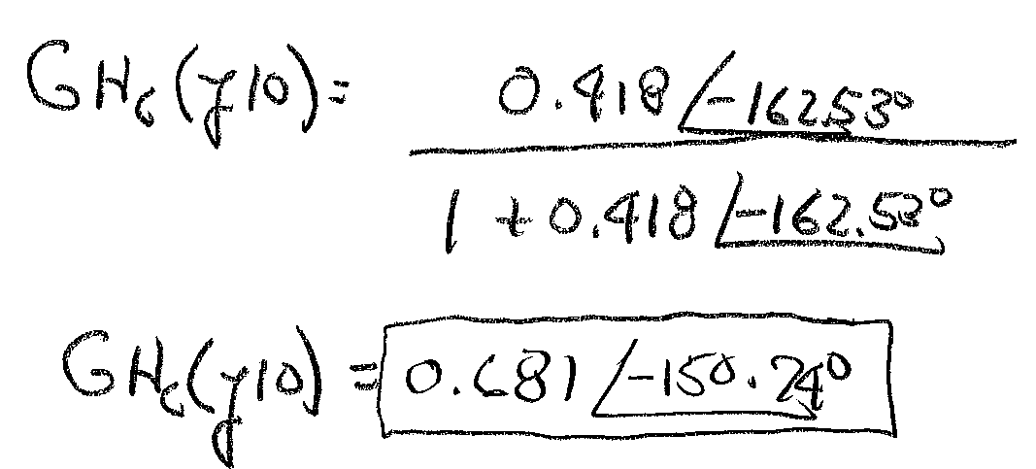
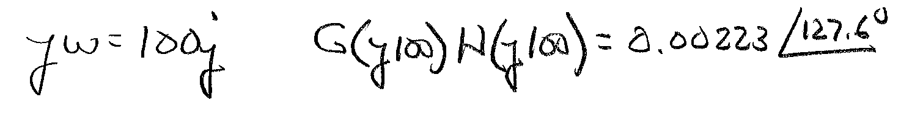
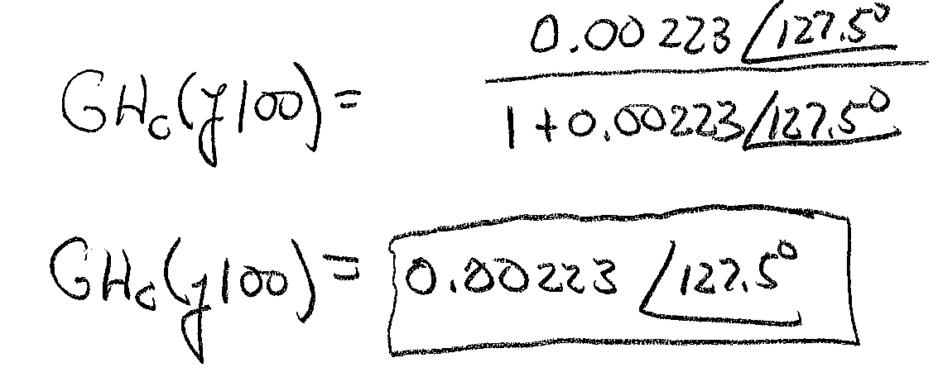
Example 21-1 Solution (12)

Slide 20
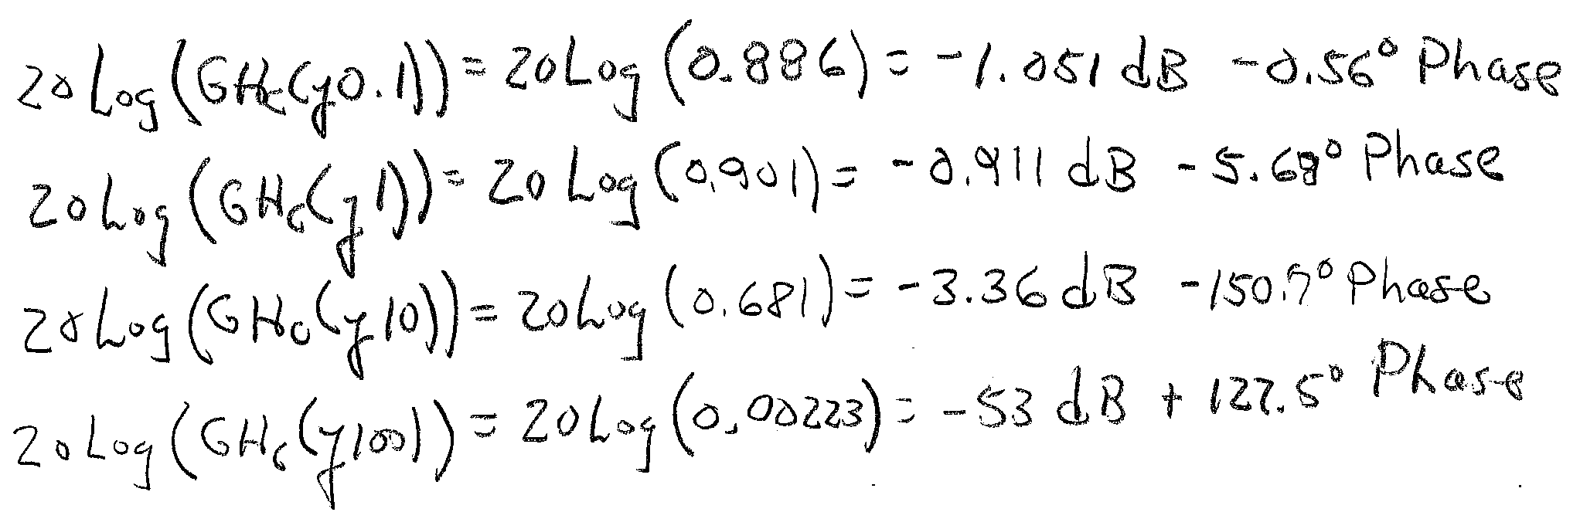
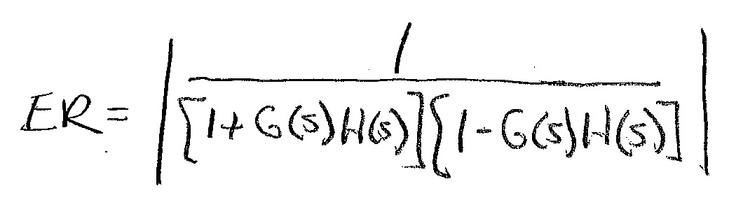
Example 21-1 Solution (13)
Convert all gain values into dB
5) Compute the values of the error ratio
Use open loop values to compute
values of ER at given frequencies

Slide 21
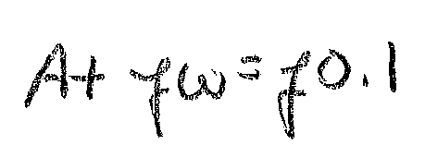
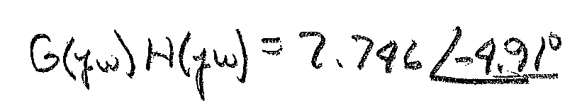
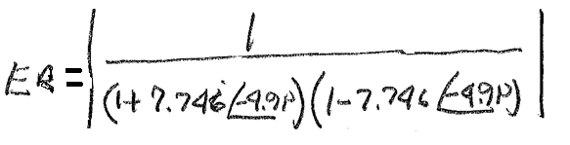
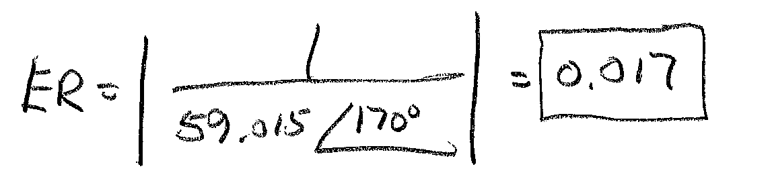
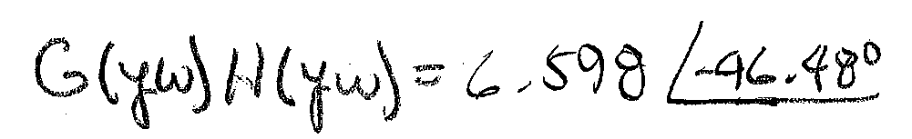
Example 21-1 Solution (14)
Now for ω=1 rad/sec

Slide 22
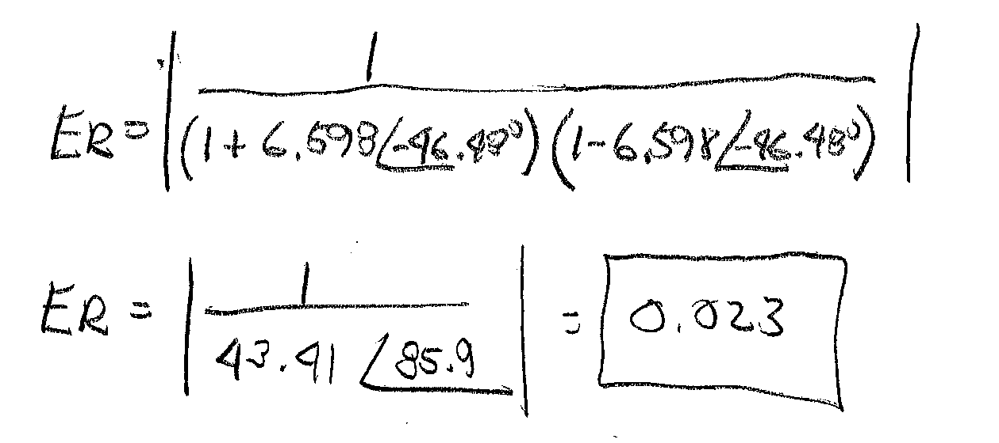
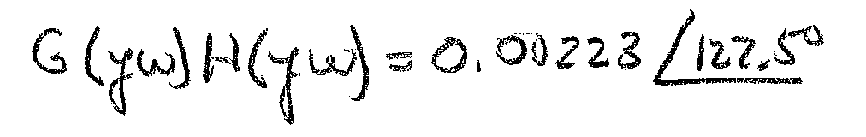
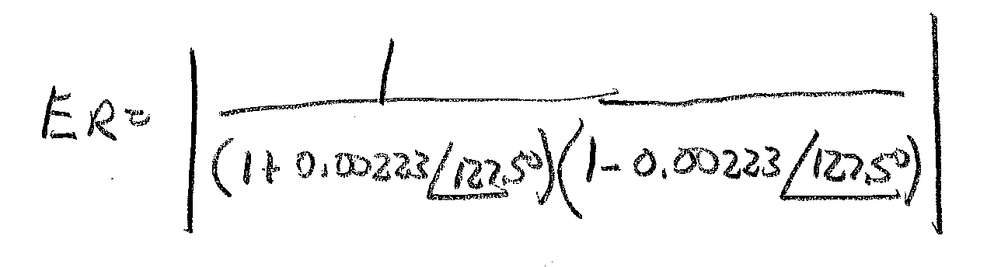

Example 21-1 Solution (15)
For ω=10 rad/sec

Slide 23

Example 21-1 Solution (16)
Convert all gain values into dB
System becomes
uncontrollable between
these two frequencies
Error ratio magnitude increases as frequency increases. It peaks and becomes a
constant value of 1 (0 dB)

Slide 24
Interpreting Error ratio plots
Define control zones
Zone 3: ER-=0 dB no control. Controller does not change error
Zone 2: ER> 0 dB poor control. Controller increases error
Zone 1: ER< 0 dB good control. Controller decreases error

Slide 25
Generating Plots using Matlab
Use MatLAB script to create open and closed loop Bode plots of example system
% Example bode calculations
clear all;
close all;
% define the forward gain numerator and denominator coefficients
numg=[21.8];
demg=[0.0063 0.379 1];
% define the feedback path gain numerator and denominators
numh=[0.356];
demh=[0.478 1];
% construct the transfer functions
G=tf(numg,demg);
H=tf(numh,demh);
% find GH(s)
GH=G*H
% find the closed loop transfer function
GHc=GH/(1+GH)
% The value in curly brackets are freq. limits
bode(GH,'go-',GHc,'r-‘,{0.1,100})

Slide 26
Bode Plots of Example 21-1

Slide 27
MatLAB Code For Error Plot Example 21-1
% Example Error Ratio calculations
clear all;
close all;
% define the forward gain numerator and denominator coefficients
numg=[21.8];
demg=[0.0063 0.379 1];
% define the feedback path gain numerator and denominators
numh=[0.356];
demh=[0.478 1];
% construct the transfer functions
G=tf(numg,demg);
H=tf(numh,demh);
% find GH(s)
GH=G*H;
% find the error ratio
ER=1/((1+GH)*(1-GH));
[mag,phase,W]=bode(ER,{0.1,100}); %Use bode plot with output sent to arrays
N=length(mag); %Find the length of the array
gain=mag(1,1:N); %Extract the magnitude from the mag array
db=20.*log10(gain); % compute the gain in dB and plot on a semilog plot
semilogx(W,db);
grid on; %Turn on the plot grid and label the axis
xlabel('Frequency (rad/s)');
ylabel('Error Ratio (dB)');

Slide 28
Error Ratio Plot
Stable to 6.5 rad/s
Zone 1
Zone 2
Error increases

Slide 29
End Lesson 21: Methods of System Analysis
ET 438a Automatic Control Systems Technology

